Slide 1
What can we do differently?
Working collaboratively

Slide 2
Welcome

Slide 3
Aim of the day
To learn how adult, children and family voluntary sector services could improve children’s outcomes by working collaboratively to deliver children’s centres or children’s centre services.

Slide 4
Local Authority
Benefits of working collaboratively

Slide 5
CVS
Benefits of working collaboratively

Slide 6
4Children National Programme
VCS and collaboration

Slide 7
Key Barriers?
Funding uncertainty?
Leadership and capacity?
Commissioning timetable and process
Skills
Attitudes of partners?
NO!

Slide 8
Co-production
Concept first developed in the 1970s

Slide 9
Lessons learned for co-production
Allow time for acceptance of ‘blank page’ approach
Agree a clear message and repeat!
Get decision makers and participants to ‘tell it as it is’
Build consensus on what the challenge is before discussing ‘solutions’
Use balance of ‘structured’ and ‘open’ conversation methods
Challenge and celebrate commissioning/
procurement practice
Process
Content

Slide 10
Q & A Panel

Slide 11
Refreshments

Slide 12
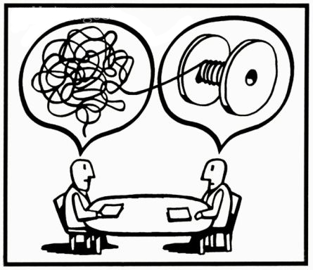
Scenario discussion and feedback

Slide 13
Open Space and feedback

Slide 14
Next steps
Thanks

