Slide 1
What can we do differently?
Working together to develop local community services

Slide 2
Welcome

Slide 3
Aim of the day
To learn how to improve children’s outcomes through the local authority, parents and the Voluntary and Community Sector working together to deliver children’s centres or children’s centre services.

Slide 4
Local Authority
Perspective on community run services

Slide 5
4Children
National Programme
Lessons in working together

Slide 6
Two year national programme
Who have we worked with?
  20 Local Authorities and VCS lead agencies
Why?
  To discover barriers faced by the local VCS in being commissioned for children’s centres and their services.
What have we done?
  National survey on commissioning barriers
  Rolling survey on attitudes to barriers
  5 provider surveys
  Training manual for VCS children centre managers
  5 focus conversation workshops
  Strategic report on mutuals
  21 activity workshops

Slide 7
We learned that Partnership overcomes barriers if:
Allow time for acceptance of ‘blank page’ approach
Agree a clear message and repeat!
Get decision makers and participants to ‘tell it as it is’
Build consensus on what the challenge is before discussing ‘solutions’
Use balance of ‘structured’ and ‘open’ conversation methods
Challenge and celebrate commissioning/
procurement practice
Process
Content

Slide 8

Q & A Panel

Slide 9
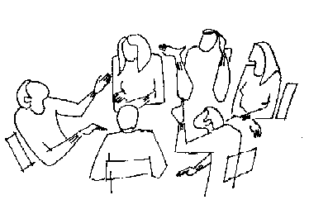
Focused conversation

Slide 10
Feedback and discussion

Slide 11

Networking and Lunch

